Slide 1
WELLINGTON STUDENT LIFE
To change the world by turning lost students into Christ-centered labourers through our movements on campus

Slide 2
THE NEED
2.5 Billion Christians
5.2 Billion
people who don’t have a personal relationship with Jesus
7.7 Billion people in the world

Slide 3
WHY STUDENTS?
HOW WE ARE FILLING THE GAP

Slide 4
HOW WE ARE REACHING STUDENTS
(WIN)
O-Week “On the Journey” Jandal Campaign
Student Life 101
Explore Studies
Q&A time

Slide 5
HOW WE BUILD STUDENTS
Action Groups
1 on 1 discipleship
Conferences and Retreats

Slide 6
HOW WE SEND
STUDENTS
Mission Trips
Committed Student Leaders
Transition/Graduation

Slide 7
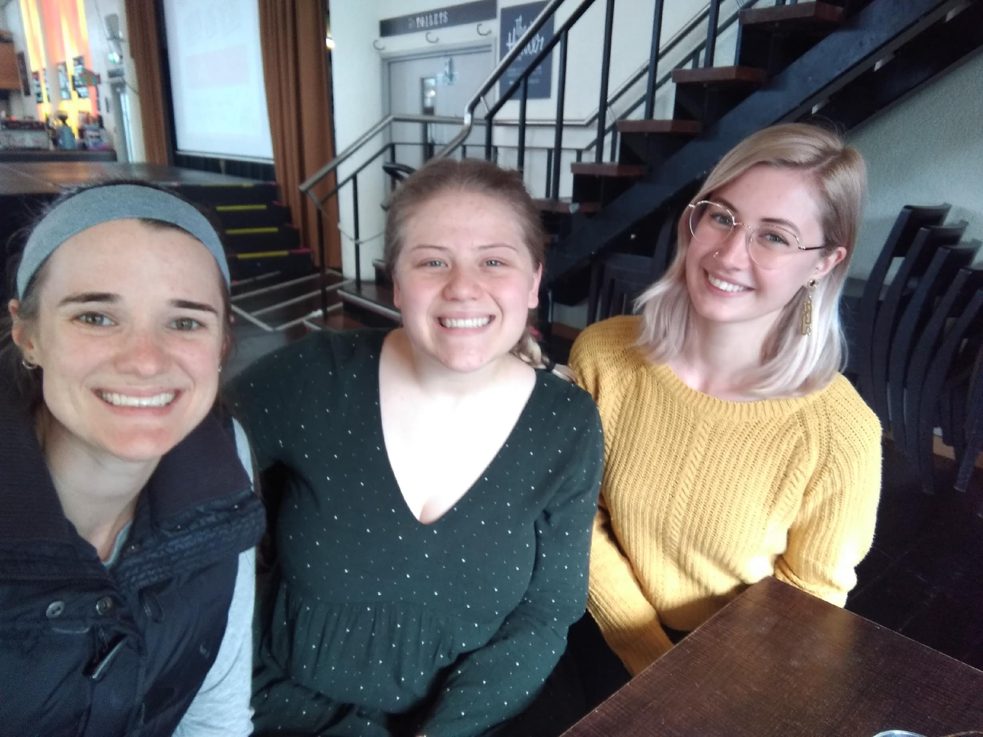
STUDENTS COME TO FAITH
KAYLI ON THE RIGHT MARYKE IN THE MIDDLE
LAUREN ON THE LEFT

Slide 8
MY CURRENT NEEDS
YOUR PRAYER SUPPORT
$1000/MO TO COVER MY ONGOING SUPPORT NEEDS

Slide 9
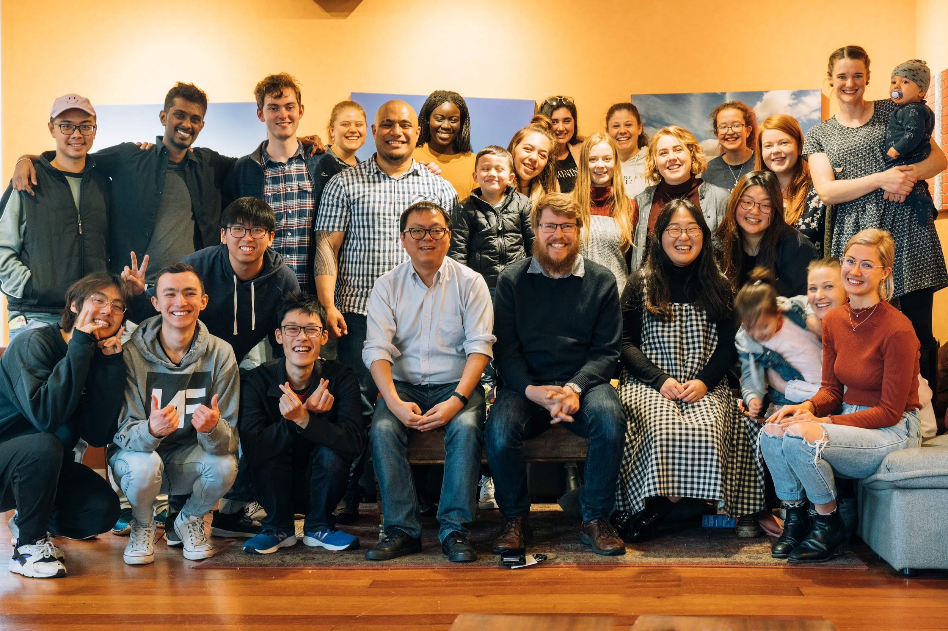
THANK YOU FOR CONSIDERING JOINING OUR MISSION TEAM!

